Slide 1
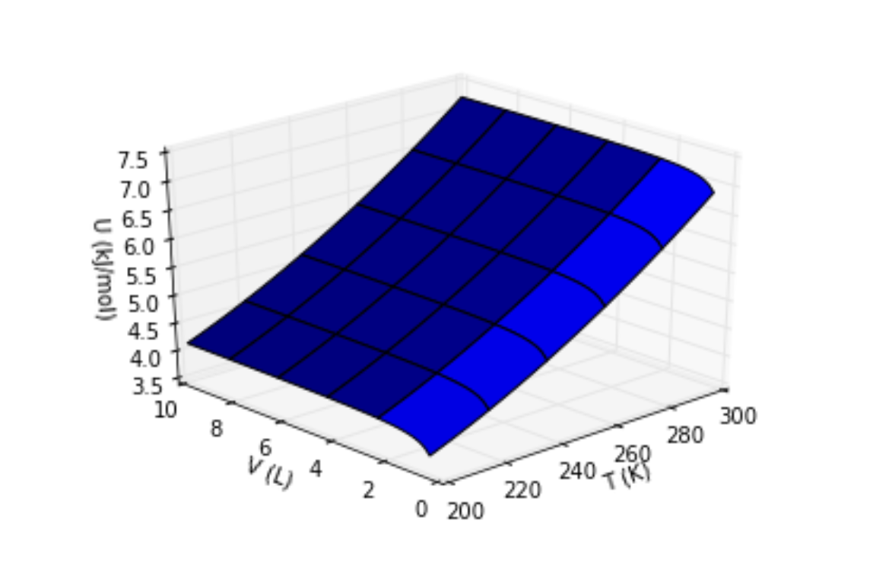
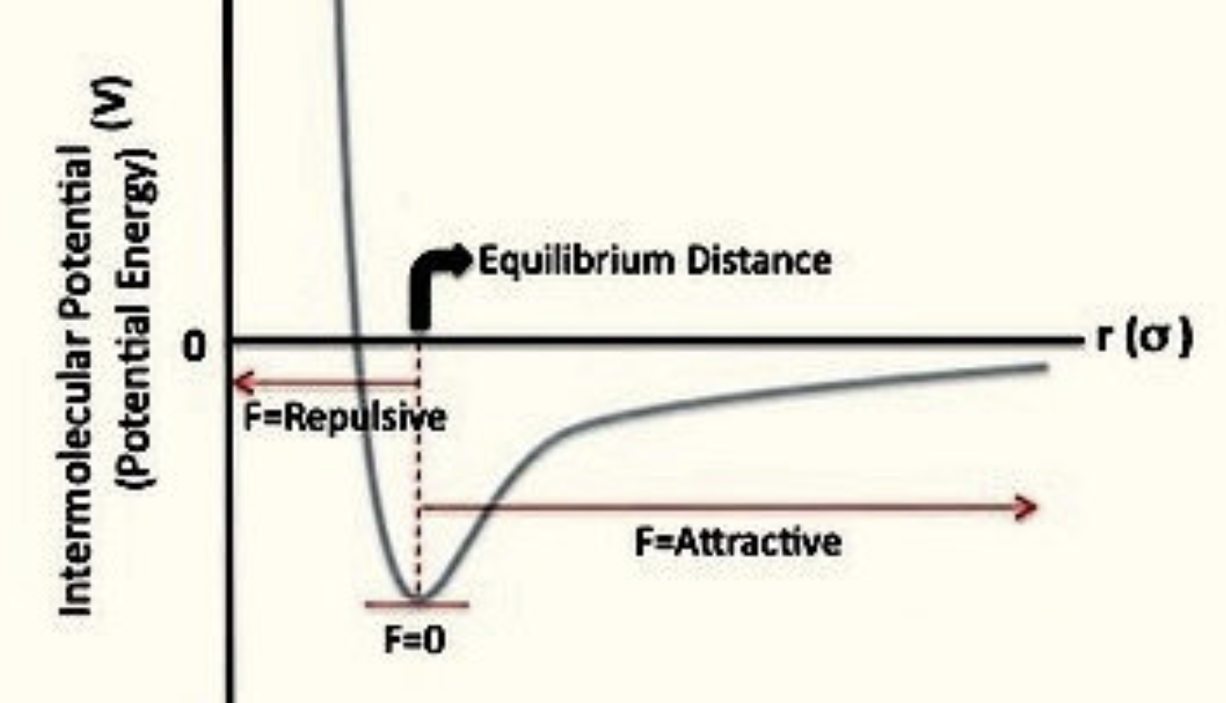
Recap: Interpreting the behavior of U in the volume direction
Why does U go up when increasing the volume?
Here’s what a typical potential energy curve looks like between two real atoms; we called this “stickiness” before.
Intermolecular attractions must be overcome when increasing the volume

Slide 2
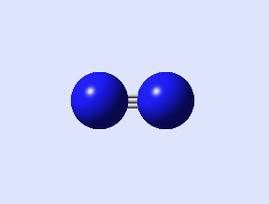
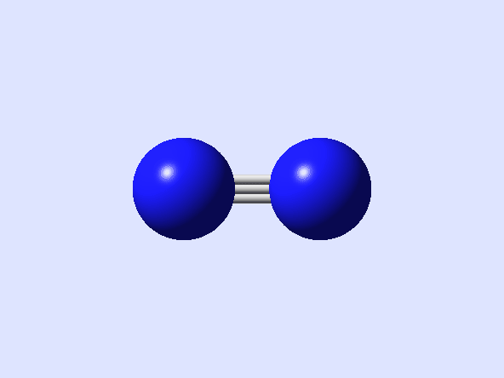
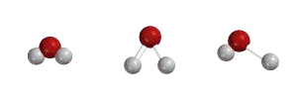
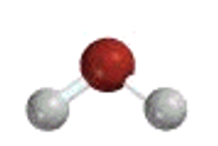
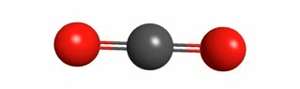
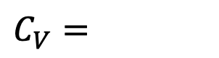
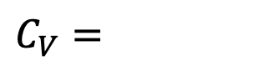
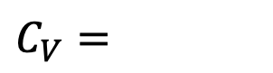
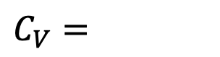
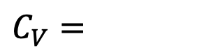
Blackboard challenge #1 – Predicting heat capacities
Predict these heat capacities
$$C_{V}=$$
$$C_{V}=$$
Low-temperature limit
High-temperature limit
$$C_{V}=$$
High-temperature limit
$$C_{V}=$$
$$C_{V}=$$
Low-temperature limit
High-temperature limit

Slide 3
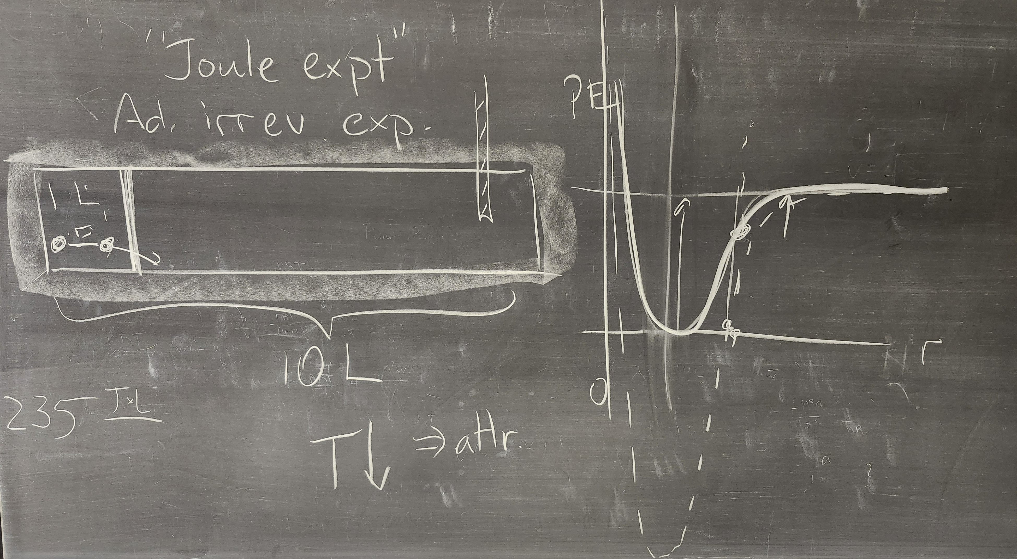
The Joule experiment

Slide 4
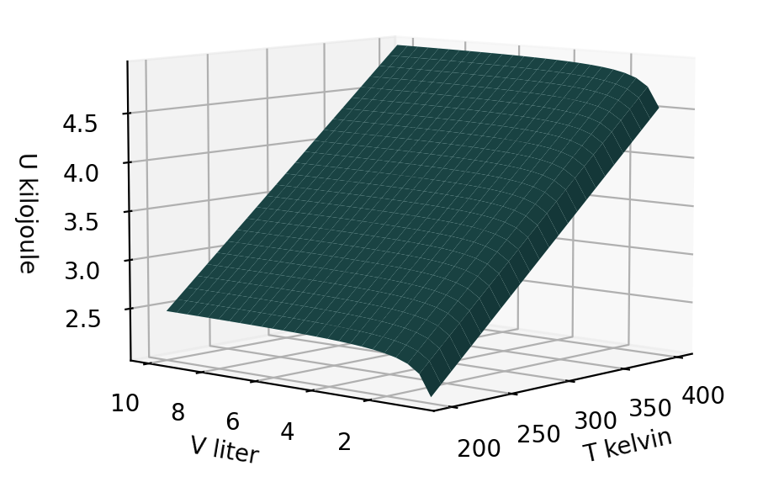
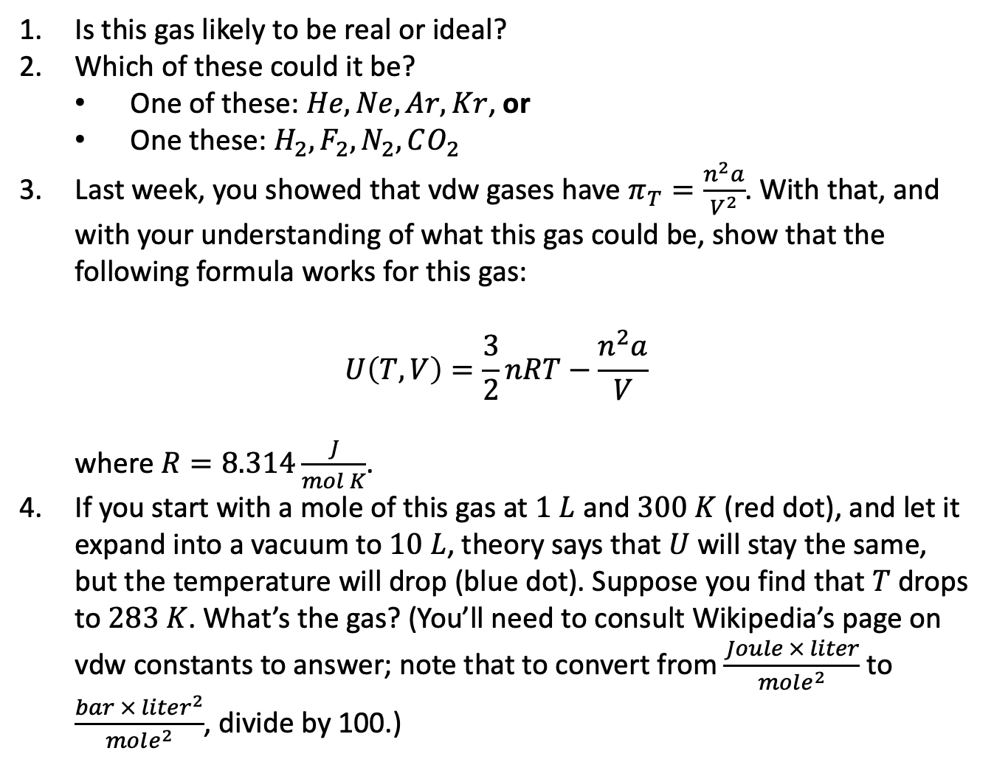
Blackboard challenge #2 – A new mystery gas
Is this gas likely to be real or ideal?
Which of these could it be?
One of these: $He, Ne, Ar, Kr$, or
One these: $H_{2},F_{2},N_{2},CO_{2}$
Last week, you showed that vdw gases have $π_{T}=\frac{n^{2}a}{V^{2}}$. With that, and with your understanding of what this gas could be, show that the following formula works for this gas:
$$U\left(T,V\right)=\frac{3}{2}nRT−\frac{n^{2}a}{V}$$
where $R=8.314\frac{J}{mol K}$.
If you start with a mole of this gas at $1 L$ and $300 K$ (red dot), and let it expand into a vacuum to $10 L$, theory says that $U$ will stay the same, but the temperature will drop (blue dot). Suppose you find that $T$ drops to $283 K$. What’s the gas? (You’ll need to consult Wikipedia’s page on vdw constants to answer; note that to convert from $\frac{Joule × liter}{mole^{2}}$ to $\frac{bar × liter^{2}}{mole^{2}}$, divide by 100.)

